Slide 1
Datascience
Exploitation de la donnée

Slide 2
Généralités
Data Science
Statistics
Machine learning
Data analysis
Domain expertise
Data engineering
Data visualization

Slide 3
What is datascience ?
Data Science
Statistics
Machine learning
Data analysis
Domain expertise
Data engineering
Data visualization
DÉFINITION
Il s’agit de l’extraction d’informations exploitables à partir de données brutes.
Ce champ multidisciplinaire a pour but principal d’identifier des tendances, des motifs, des connexions et des corrélations dans les larges ensembles de données.
DISCIPLINES

Slide 4
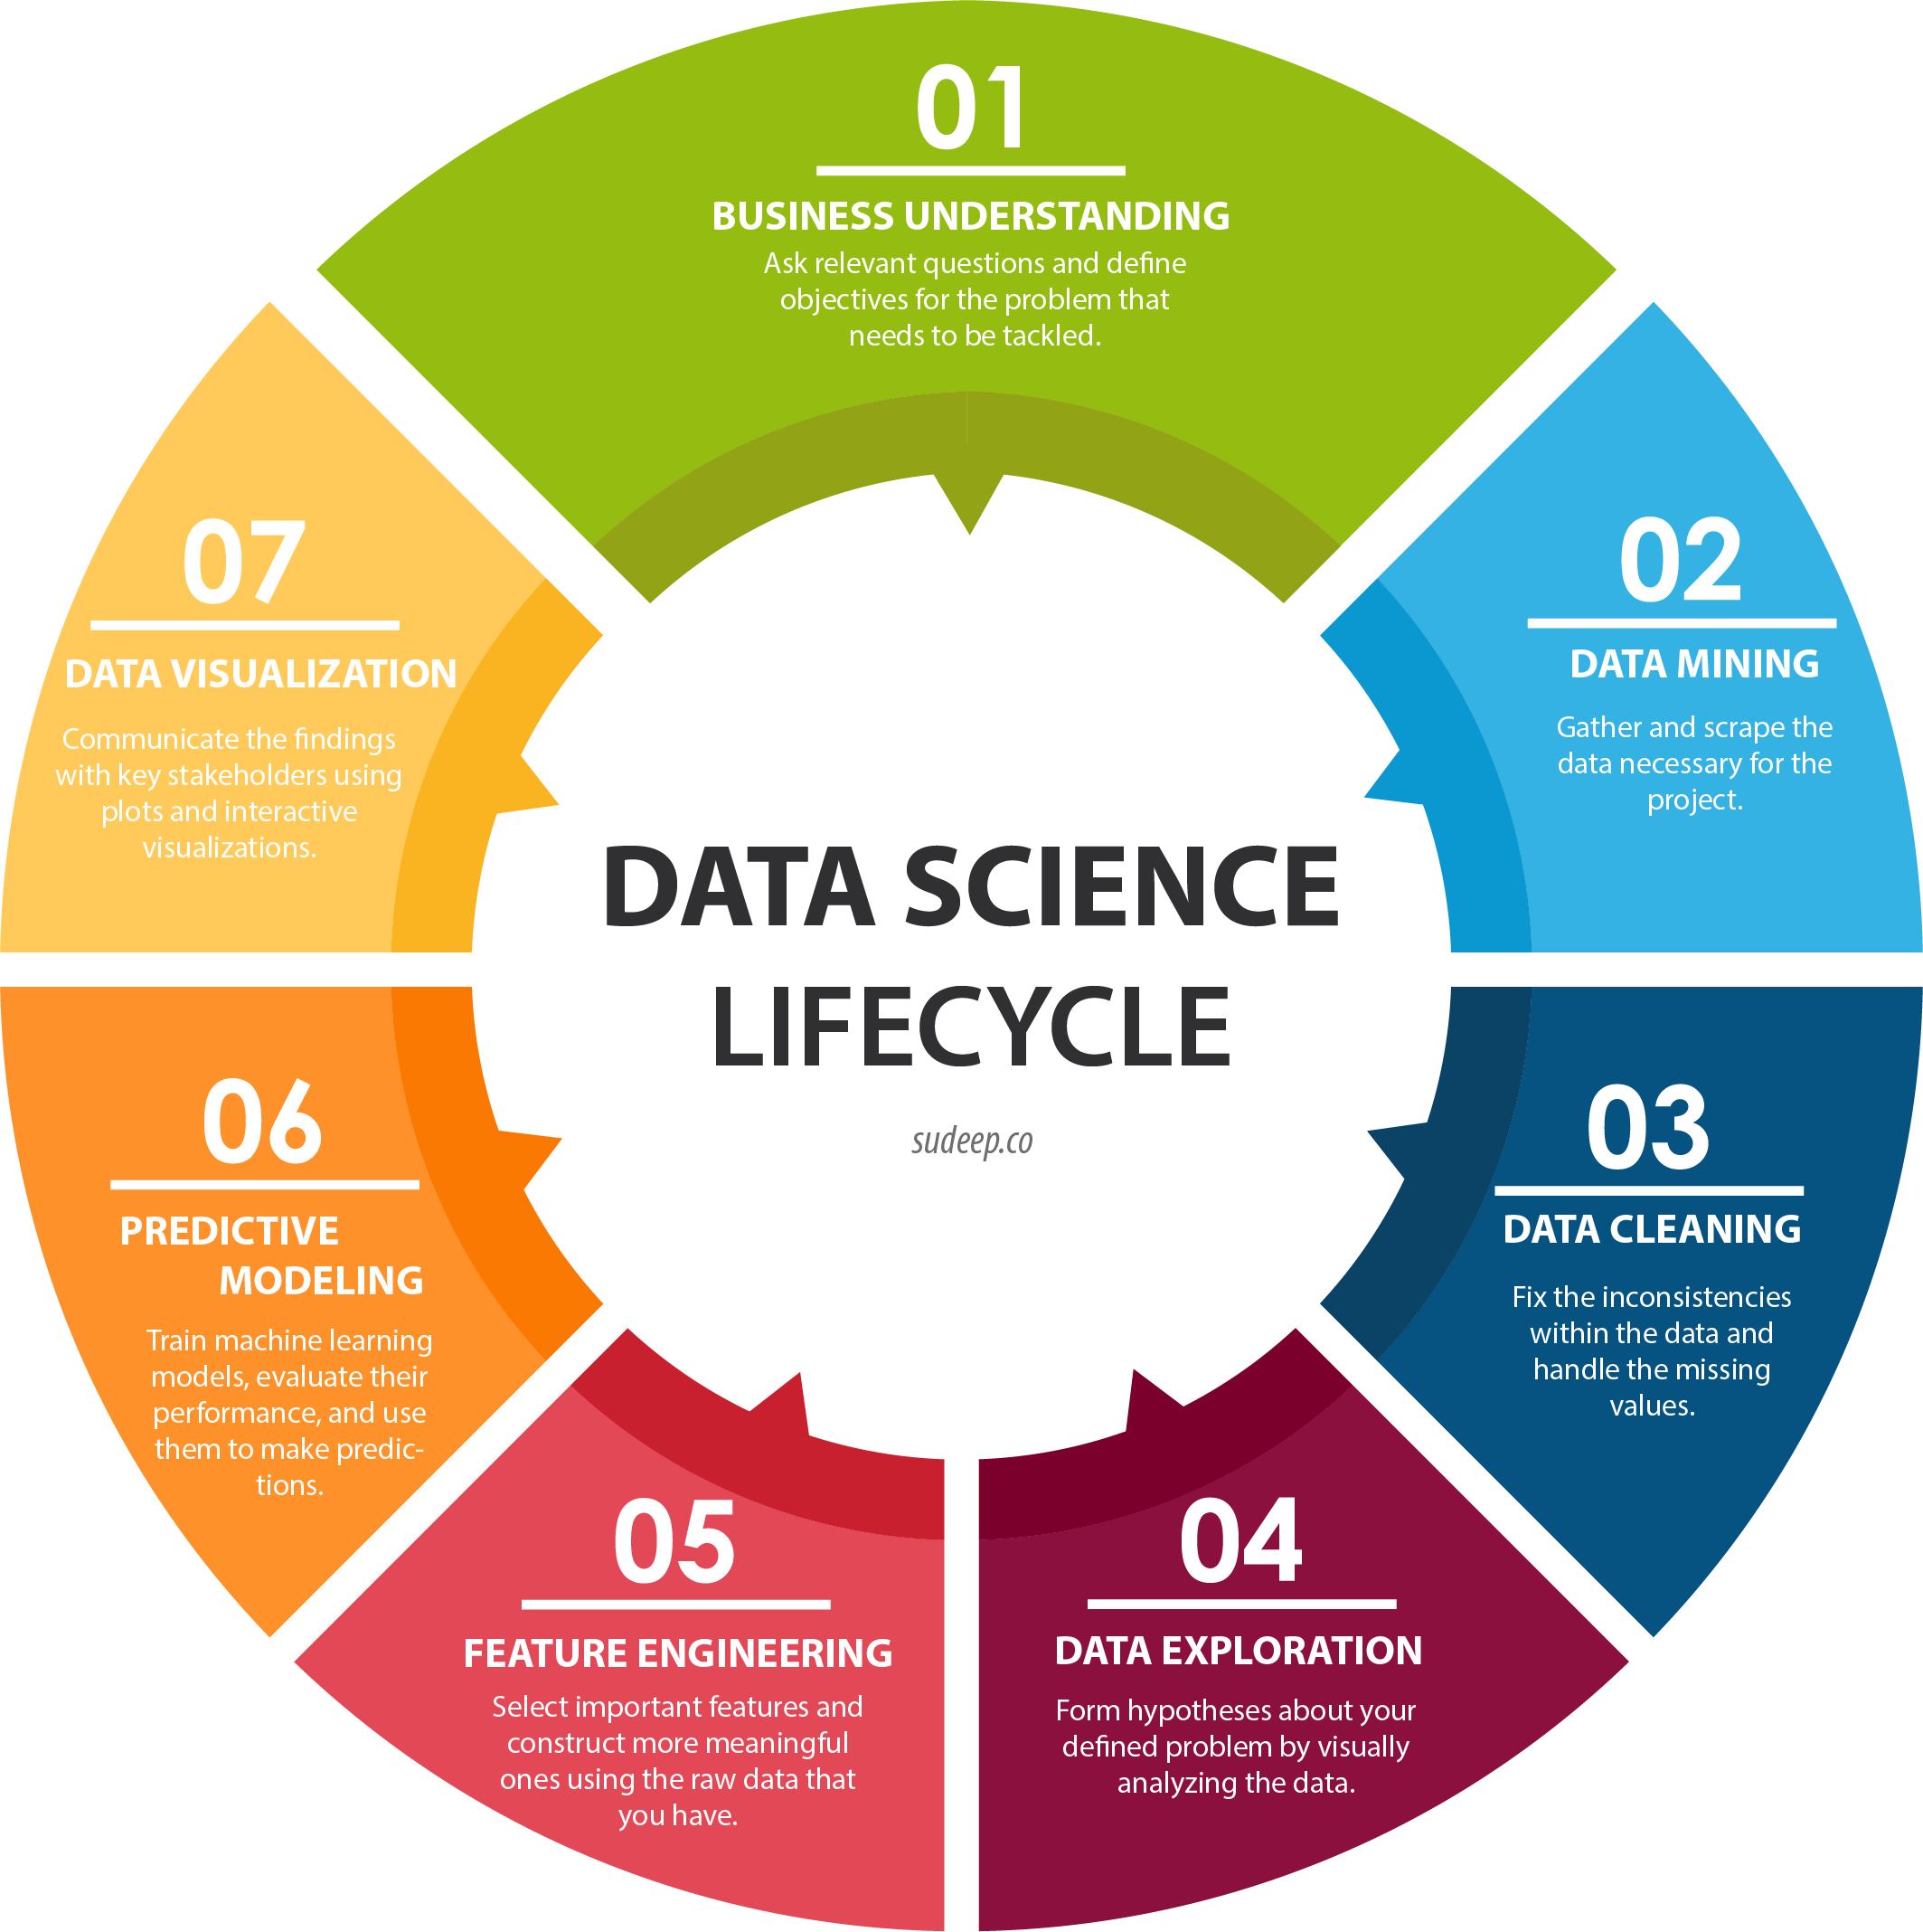
Examples
DATA ENGINEERING
Demand prediction for the manufacturing industry
Supply chain optimization in the logistics industry
Recommendation systems in marketing & advertising
Credit scoring for financial institutions
Diagnostic help in healthcare (MRI)
Image from Sudeep.co

Slide 5
Application areas
FINANCE
Asset pricing, trading strategies, …
HEALTHCARE
Epidemiology, diagnostic help, …
GOVERNEMENT
Security, Public Policy, Climate Change
MANUFACTORING
Predictive Maintenance, quality control, …
WEB INDUSTRY
Clickthrough Ads, Marketing, …
TRANSPORTATION
Airline promotions, passengers optimization
RETAIL
Pricing, Discounts, Market basket analysis
ENERGY
Electricity consumption prediction, …
Everywhere…

Slide 6





Les plateformes « all-in »
Certaines plateformes proposent des solutions couvrant la quasi-totalité des disciplines de datascience (et d’autres services…) :
Et d’autres sont spécialisées, par exemple dans les systèmes embarqués:

Slide 7
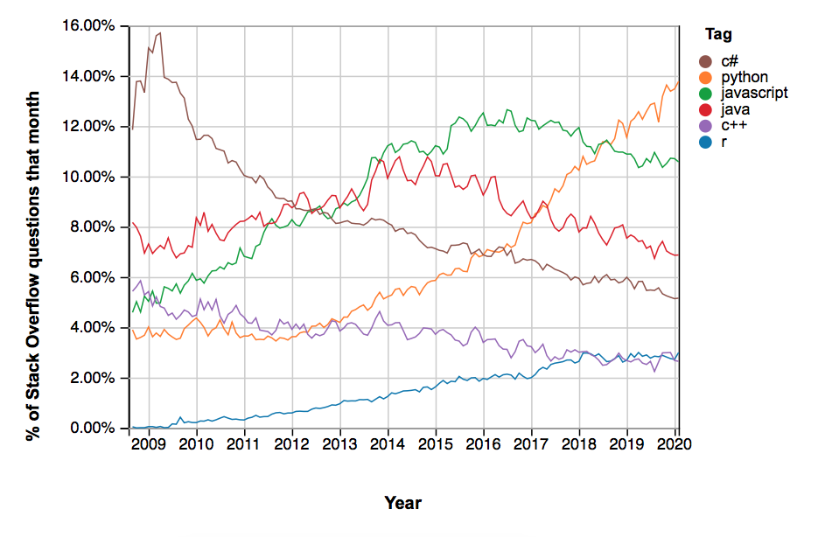

python
python is clearly a growing langage
interpreted, easy-to-use
best for data science
a lot of opensource libraries

Slide 8

Google colab
Extrait de la page d’accueil google colab
Colab (ou "Colaboratory") vous permet d'écrire et d'exécuter du code Python dans votre navigateur avec:
aucune configuration requise
Accès sans frais aux GPU
Partage facile
Que vous soyez étudiant, data scientist ou chercheur en IA, Colab peut vous simplifier la tâche. Regardez la présentation de Colab pour en savoir plus ou commencez tout de suite.

Slide 9
python – extra slide
Virtual env
We use python within google colab, so no setup is required
BUT: If you use python with scripts, please use it in a virtual environment.
Package management
To install a new package/library you need a package manager. The most common are:
pip
conda
poetry
IDE
Two most common :
Visual Studio Code
PyCharm

Slide 10


python – basic librairies

Slide 11
Data analysis
Data Science
Statistics
Machine learning
Data analysis
Domain expertise
Data engineering
Data visualization
Let’s code !

Slide 12
Les types de données
Qualitatif
NOMINAL DATA
ORDINAL DATA
Quantitatif
DISCRETE DATA
CONTINUOUS DATA
Genre (homme, femme)
Couleur de cheveux (blond, brun, roux)
Pays d’origine (France, Allemagne, …)
Classement sportif (1er, 2ème,…)
Note d’examen (12/20, 14/20, …)
Expérience professionnelle (junior, mode, senior)
Nombre d’étudiants dans une classe
Nombre d’employés d’une boîte
Nombre de likes Facebook
Vitesse de voitures sur une route
Température d’ébullition de l’eau
Taille d’individus

Slide 13

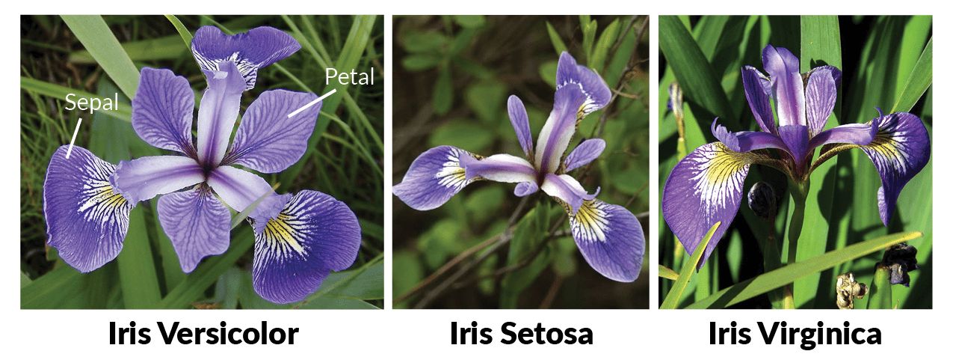
Open Datasets
Multiple websites offers open datasets to work with:
Kaggle
Awesome Public Datasets
Data World
Some datasets are very famous and you can find a lot of examples based on them:
Boston Housing dataset
IRIS dataset
MNIST dataset
…
IRIS dataset images

Slide 14
Statistics
Data Science
Statistics
Machine learning
Data analysis
Domain expertise
Data engineering
Data visualization
Some concepts to understand

Slide 15
Statistical sampling
Are my data representative of the population ?
Population: whole data, often not available
Cancer images of europeean people under 30
Clicks positions on amazon.com
Sample: part of the population
Cancer images from a hospital in Berlin
Clicks positions on amazon.com in February 2020
Domain expertise
Domain expertise
DOMAIN EXPERTISE !

Slide 16
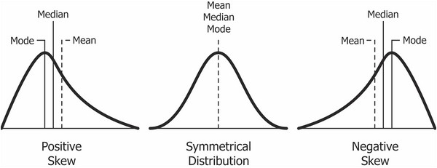
Descriptive statistics
Many statistical features/characteristics can be extracted from data to improve our understanding:
mean
median
mode
quantiles
standard deviation
skewness
…
FEATURES

Slide 17
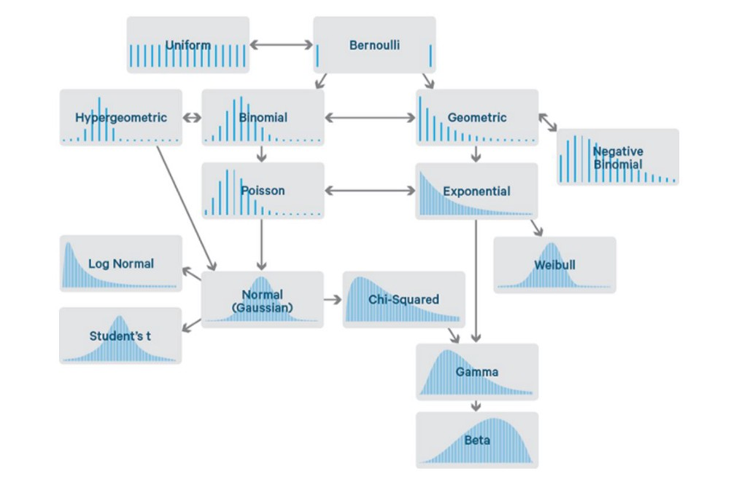
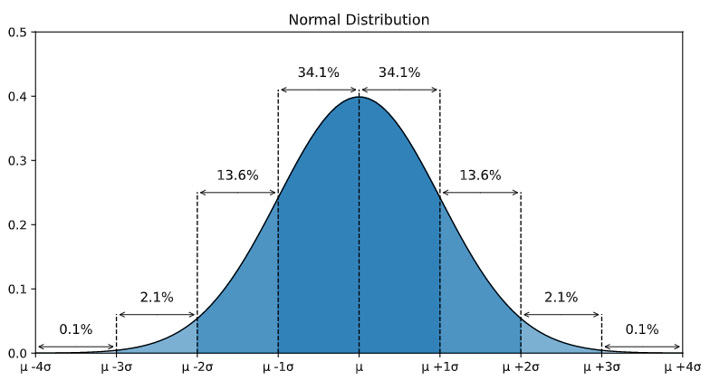
Distributions
Descriptive statistics are useful but they can often hide important information about the data set.
A distribution is a chart, often a histogram, that displays the frequency with which each value appears in a data set. This type of chart gives us information about the spread and skewness of the data.
Don’t forget that world is pretty normal
the one to know

Slide 18
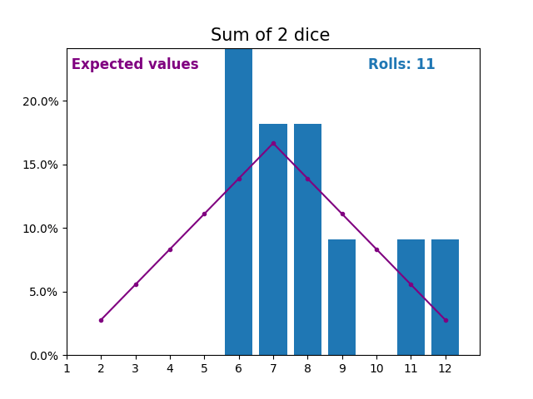
Probability
Being able to give the probability of an event is very informative/interesting.
Let say a casino have a game with 2 dices. They know sometimes people cheat by switching the dices with falsified ones. They want you to find a way to detect wrong pair of dices. How would you do ?
One solution:
We can mathematically compute the probability of each output, from 2 to 12.
Now we are able to compute the probability of having multiple high outputs in a row.
For each game, we analyse the last 20(?) rolls (keeping temporality)
If the probability of having such rolls decreases drastically, that might result from falsified dices ?
NO NEED FOR MACHINE LEARNING HERE !

Slide 19
Probability – extra slide
What we did with dices could be applied on many other data
medical, financial, industrial,…
Probabilities are the basis of many machine learning algorithms
Naive Bayes, Gaussian Mixture,…
A strength of probabilistic models is that they are easier to interpret

Slide 20
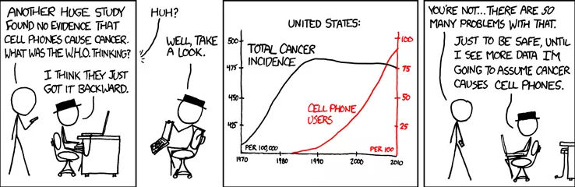
Correlation
DEFINITION
Correlation is a statistical technique that measures relationships between two variables.
Be aware that correlation analysis can reveal meaningful relationships between variables, but that one must take precautions before concluding anything.
CORRELATION ≠ CAUSATION
source

Slide 21
Data visualisation
Data Science
Statistics
Machine learning
Data analysis
Domain expertise
Data engineering
Data visualization

Slide 22

Visualisation librairies
matplotlib
The most common visualisation library. Full support for static plots.
→ See matplotlib gallery
plotly
A common visualisation library that natively support interactive plots. Very usefulfor small amount of data.
→ See plotly gallery
seaborn
A common visualisation library that provides a lot of well-designed static plots
→ See seaborn gallery
bokeh
A relatively common visualisation library that provides well-designed interactive plots and is compatible with holoviews for large amount of data
→ See bokeh gallery

Slide 23
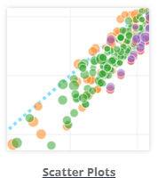
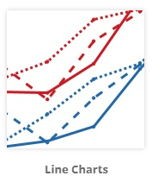
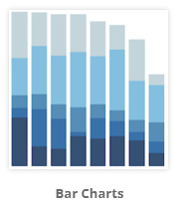
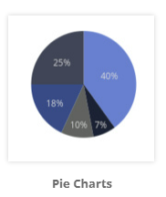
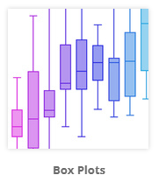
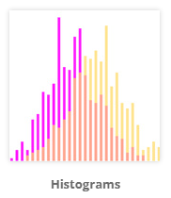
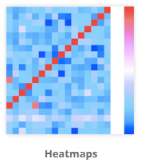
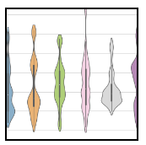
Basic charts to know (subjective…)
Violin plot

Slide 24

How to process
Identify the chart you want to plot
Chart must be selected regarding what you want to highlight
Select a library (need interaction ? lot of data ?)
Read the doc and use the gallery example
Update the plot to add what you need
If you cannot manage to do it on your own, ask google (prefer stackoverflow or the library’s forum)
Read the error you have in your code, search on google, update
Repeat previous step until you have the chart you want

Slide 25
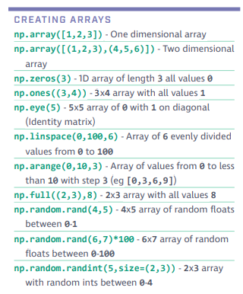
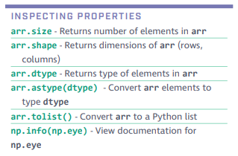
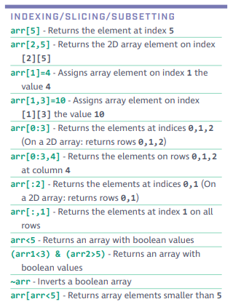
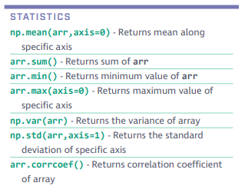
Numpy cheet sheat

Slide 26
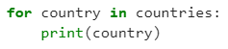
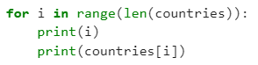
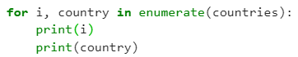
Numpy cheet sheat
Iteration over 1d-array/list
Dataframe et mask

Slide 27
Machine Learning
Data Science
Statistics
Machine learning
Data analysis
Domain expertise
Data engineering
Data visualization

Slide 28
Definition
Machine Learning is the process of training a piece of software, called a model, to make useful predictions from data. An ML model represents the mathematical relationship between the elements of data that an ML system uses to make predictions.
BASIC IDEA
CLASSICAL APPROACH
MACHINE LEARNING
Input
Model
Output ?
Input
Model ?
Output

Slide 29
Your turn
?
AI Terms

Slide 30
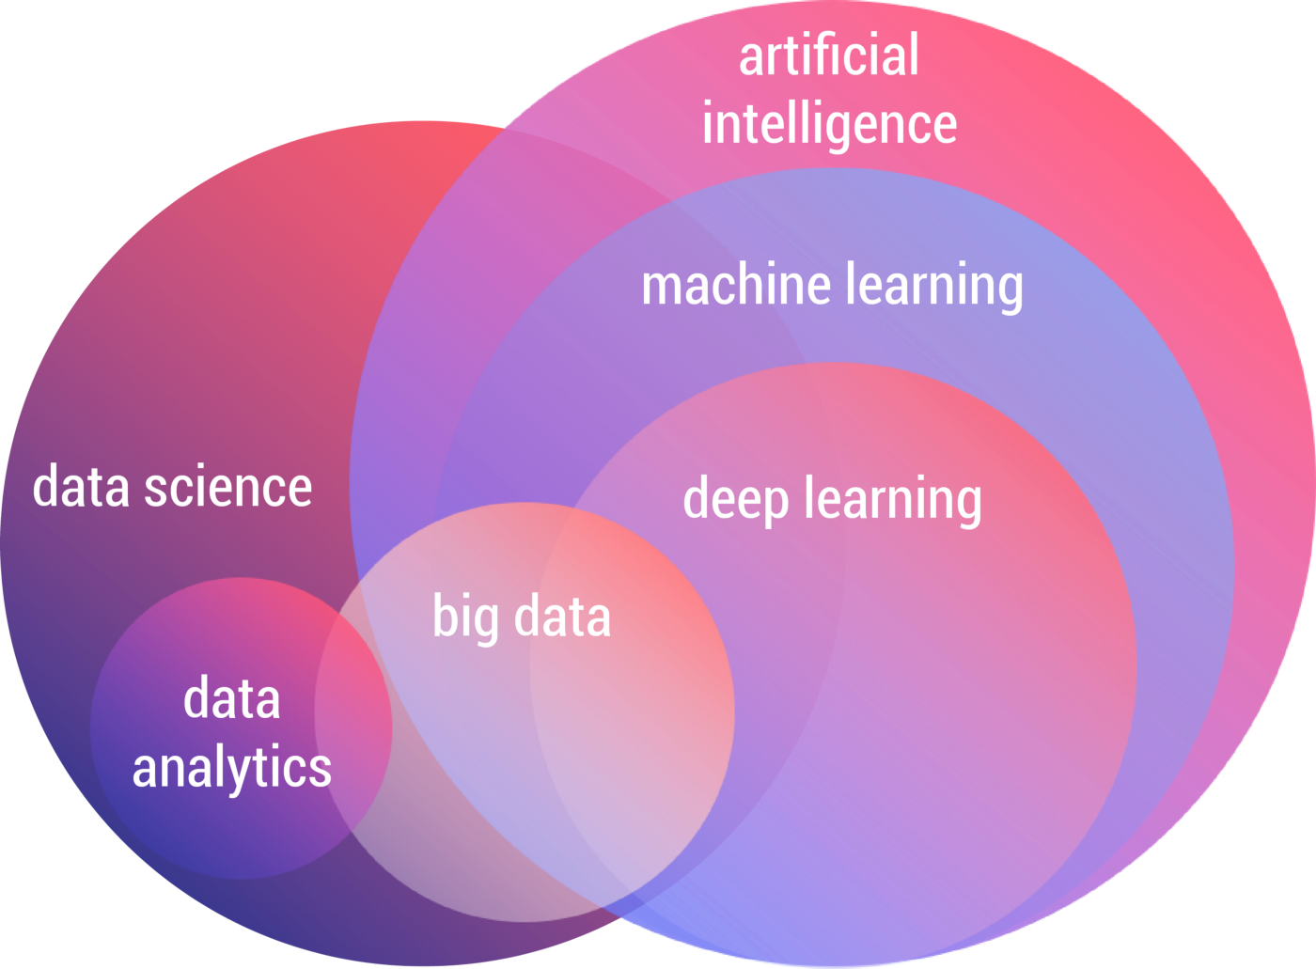
NLP
Agglomerative clustering
OSVM
CNN
Reinforcement learning
GRU
RNN
Markov
Machine learning
LSTM
LDA
Convolutions
Naive Bayesian
Deep learning
SVM
Unsupervised learning
Maintenance prédictive
Apprentissage
KNN
Supervised learning
Random forest
IA
Réseau de neurone
Note: all AI domains representations are right and wrong

Slide 31

Machine Learning areas
sklearn introduction
Supervised learning models can make predictions after seeing lots of data with the correct answers and then discovering the connections between the elements in the data that produce the correct answers
A Regression model predicts a numeric value
Classification models predict the likelihood that something belongs to a category
An unsupervised learning model's goal is to identify meaningful patterns among the data without knowing the correct answers.
Reinforcement learning models make predictions by getting rewards or penalties based on actions performed within an environment.
Recommended to read: What is ML by Google

Slide 32
How does a classifier work
Let say we have humidity and temperature data from multiple wine cellars labeled good-tasting or not good-tasting.
Training
Testing
Label 1 Good-tasting wine
New data to predict → What label ?
Label 2 Not good-tasting wine
Model
Another model
Feature 1
Wine Cellar humidity
Model
Feature 1
Wine Cellar humidity
Another model
Feature 2
Wine cellar temperature
Feature 2
Wine cellar temperature

Slide 33
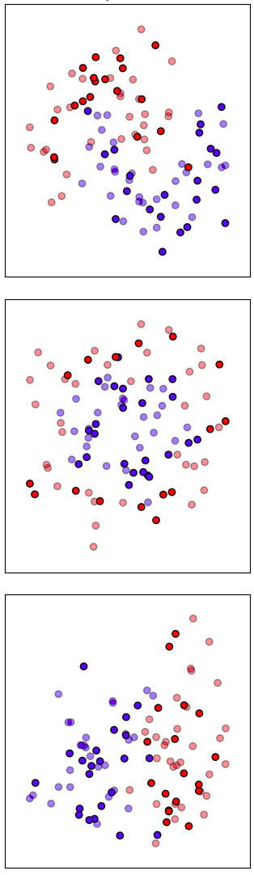
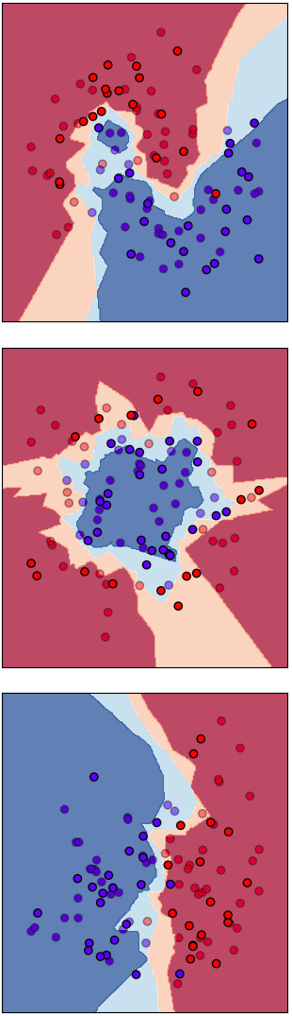
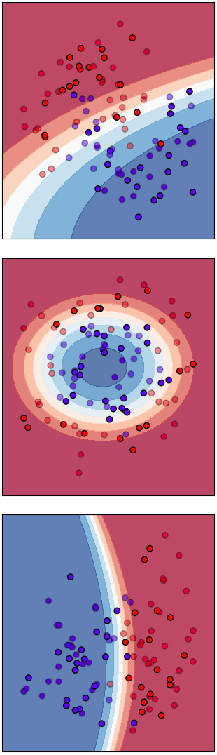
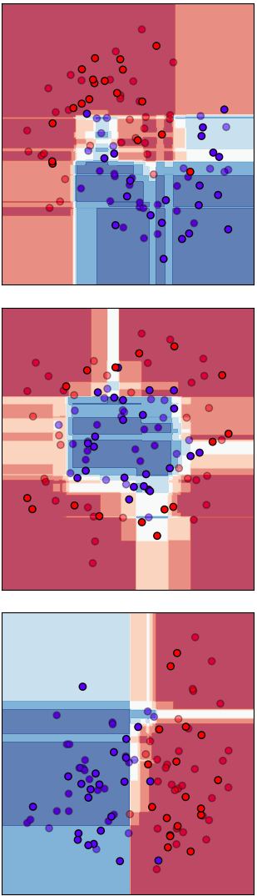
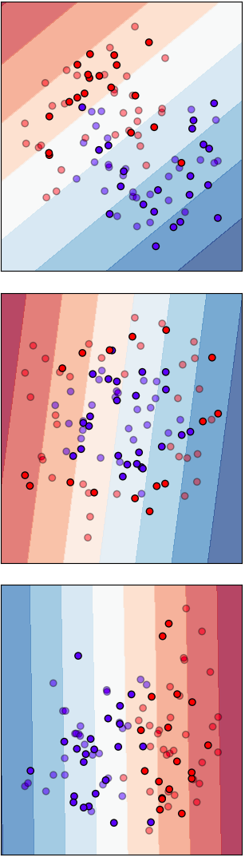
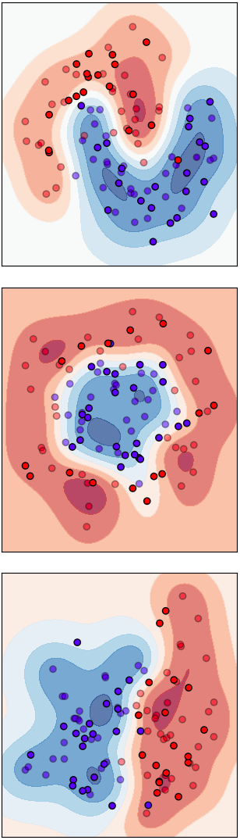
Why so many classifiers ?
Inputs
Nearest
Neighbors
Naive
Bayes
Random
Forest
Linear
SVM
RBF
SVM

Slide 34
Process to validate a classifier
CODE CONVENTION
X → features
y → labels/target
Hyperparameters
Tuning
Performance evaluation (metrics)
Misclassification analysis
Classifier &
features choice
Labeled Features
Model with expected performances

Slide 35
K-Nearest Neighbors
code sklearn KNeighborsClassifier
K : Number of neighbors to look
At each new sample, the algorithm chooses the label of the K-nearest neighbors majority
Training
Testing
New sample to classify
Feature 1
Wine Cellar humidity
K=7
K=3
Feature 2
Wine cellar temperature

Slide 36
K-Nearest Neighbors
code sklearn KNeighborsClassifier
Advantages
Drawbacks
Easy to understand
Distribution agnostic
No need to “train” the model
Easy to implement
Easy to tune
Note
Data must be scaled !
Could be slow to compute
computation time ~ o(DN²) with D features and N samples
There are approaches to reduce it (KD-tree)
Not good for different distribution densities (some kNN-based algorithm are...) or unbalanced data
Outlier sensitivity

Slide 37
Random Forest
code sklearn RandomForestClassifier
Dataset
How does a decision tree work ?
Dataset :
1 1 0 0 0 0 0
2 features : [ red / blue ] and [ underlined / not underlined ]
Labels: 1 / 0
Random subset 1
Random subset 2
Random subset n
→ Iteratively, the tree selects the best feature, which is the one which best separates the dataset (information gain)
1 1 0 0 0 0 0
Decision tree 1
Decision tree 2
Decision tree n
?
is red ?
1 1 0
0 0 0 0
Majority-Vote
is underlined ?
1 1
0
Random forest works well because it creates decorrelated trees (see ensemble learning).

Slide 38
Random Forest
code sklearn RandomForestClassifier
Advantages
Drawbacks
Requires a small amount of data to train
Data does not need to be rescaled or transformed
Great with high dimensionality
Parallelizable
Can handle unbalanced data
Hard to overfit if well-used
Large trees could lead to memory issues

Slide 39
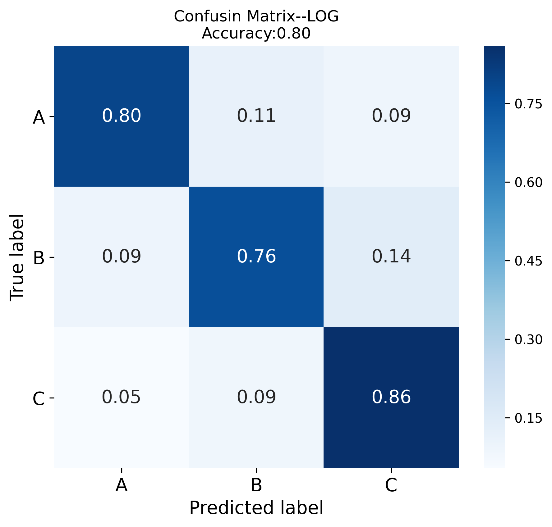
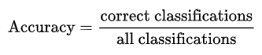
Classification metrics
code sklearn ConfusionMatrixDisplay
To evaluate your model, you need relevant metrics.
Metrics depend of your objective
In classification, many metrics are based on
False Positives
False Negatives
True Positives
True Negatives
Some common metrics: accuracy, confusion matrix, AUC,…
→ Be careful with imbalanced data !

Slide 40
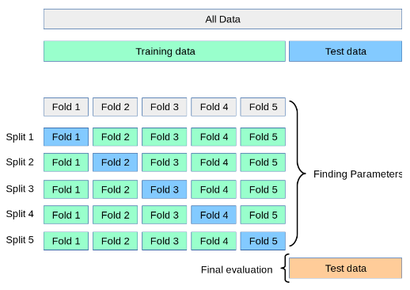
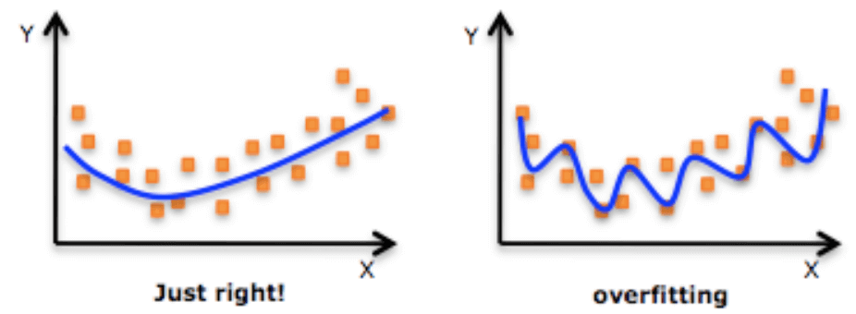
Data split
code sklearn train_test_split, cross_val_score
When you evaluate a model, you don’t want to use the data that has already been seen, otherwise your model might have just memorized your data which can lead to overfitting.
You want your model to be able to generalize.
They are plenty methods to avoid overfitting while improving generalization. First thing to do is to separate your training data from your testing.
See sklearn cross-validation page

Slide 41
To go further
Here are some important concepts that we won’t see in details:
Standardization, or mean removal and variance scaling
Tuning the hyper-parameters of an estimator
code StandardScaler
code GridSearchCV
See sklearn cross-validation page

